Slide 1
Chapter 1

Slide 2
Objectives

Slide 3
Objectives (continued)

Slide 4
Objectives (continued)

Slide 5
The components of a web application

Slide 6
Terms

Slide 7
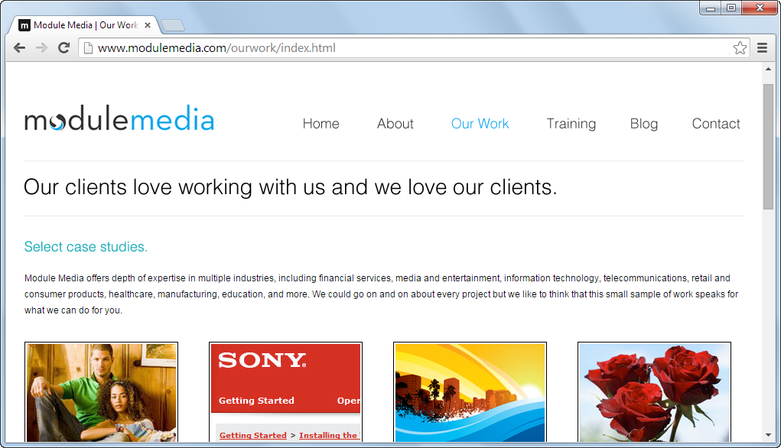
A static web page (index.html)

Slide 8
How a web server processes a static web page

Slide 9
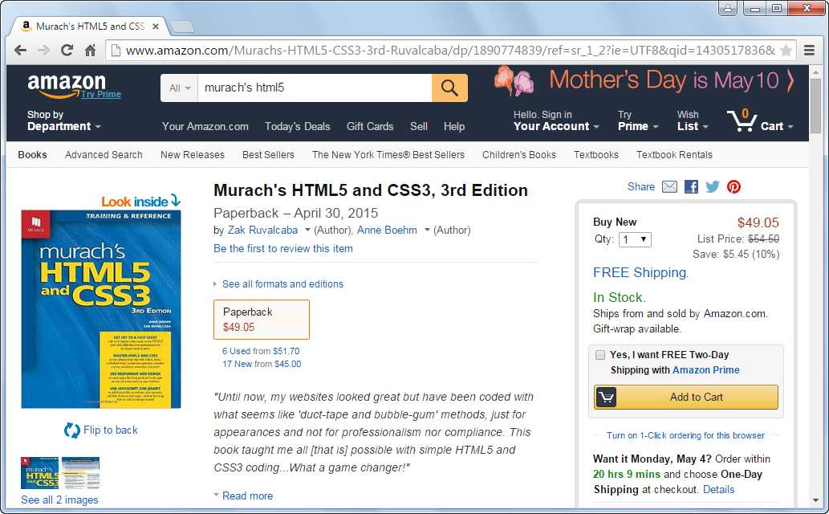
A dynamic web page at amazon.com

Slide 10
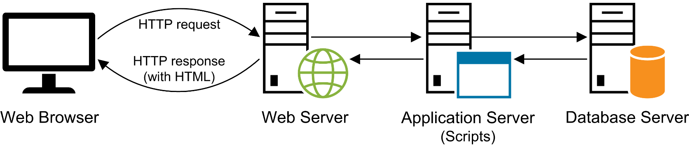
How a web server processes a dynamic web page

Slide 11
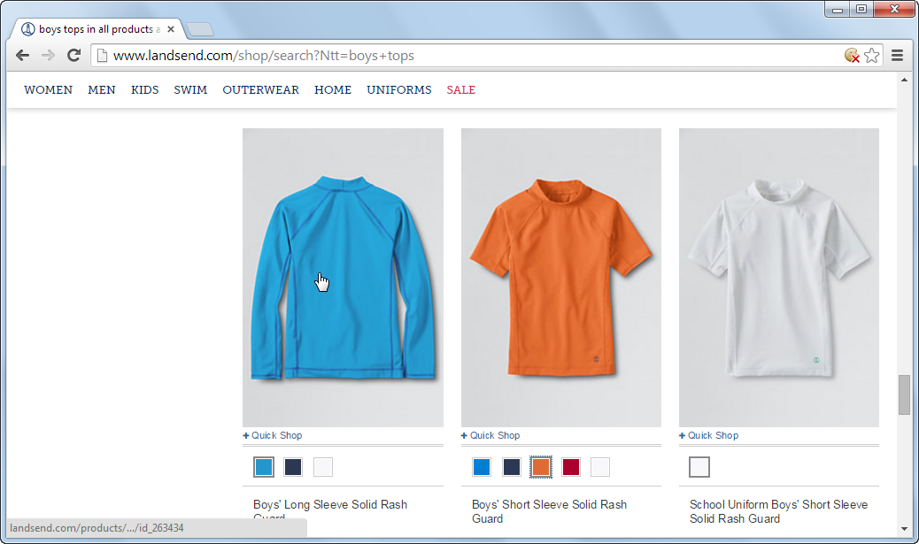
A web page with image swaps and rollovers

Slide 12
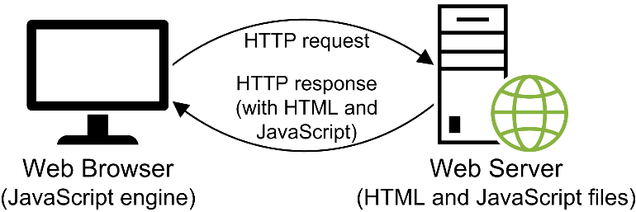
How JavaScript fits into this architecture

Slide 13
Some of the JavaScript and jQuery

Slide 14
The versions and release dates of the ECMAScript specification

Slide 15
Some of the important additions in the ECMAScript 5 specification

Slide 16
The URL for the ECMAScript 6 specification

Slide 17
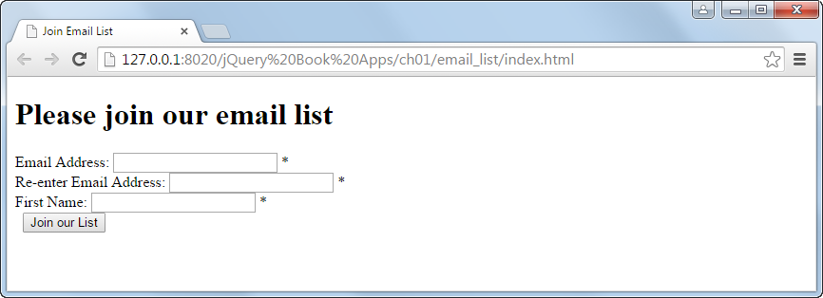
An HTML file (index.html) in a browser with no CSS applied to it

Slide 18
The code for the HTML file named index.html

Slide 19
The HTML file named index.html (continued)

Slide 20
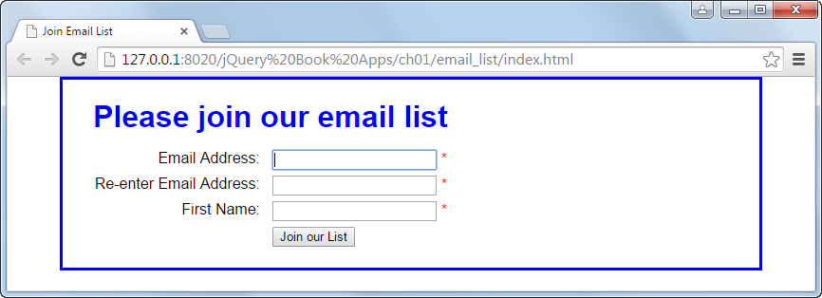
The web page in a browser after CSS has been applied to it

Slide 21
The link element that applies the CSS file

Slide 22
The CSS file named email_list.css (continued)

Slide 23
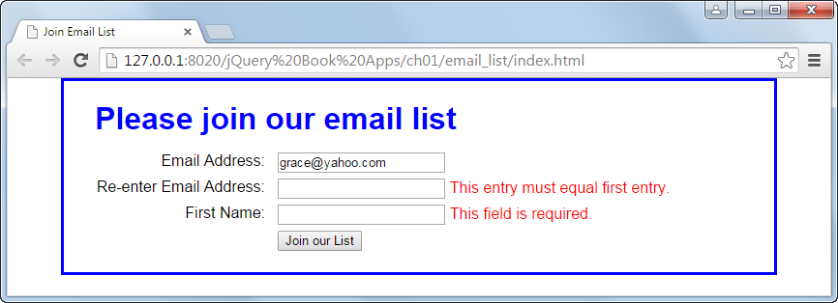
The web page in a browser with JavaScript used for data validation

Slide 24
The code for the JavaScript file (email_list.js)

Slide 25
The JavaScript (continued)

Slide 26
The primary HTML5 semantic elements

Slide 27
A page that’s structured with HTML5 elements

Slide 28
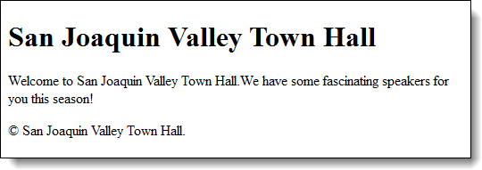
The HTML in a web browser

Slide 29
HTML div elements for a JavaScript application

Slide 30
HTML span elements for a JavaScript application

Slide 31
The basic HTML attributes

Slide 32
HTML that uses these attributes

Slide 33
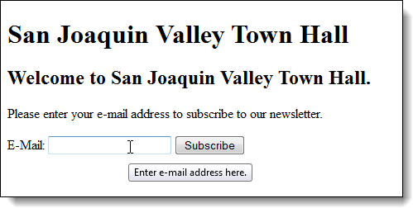
The HTML in a web browser with a tooltip displayed for the text box

Slide 34
Two ways to provide styles

Slide 35
A head element that includes two style sheets

Slide 36
HTML that can be selected by type, id, or class

Slide 37
CSS rule sets that select by type, id, and class

Slide 38
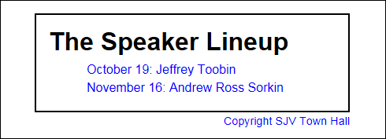
The HTML elements in a browser

Slide 39
The CSS file for a typical application in this book

Slide 40
Terms

Slide 41
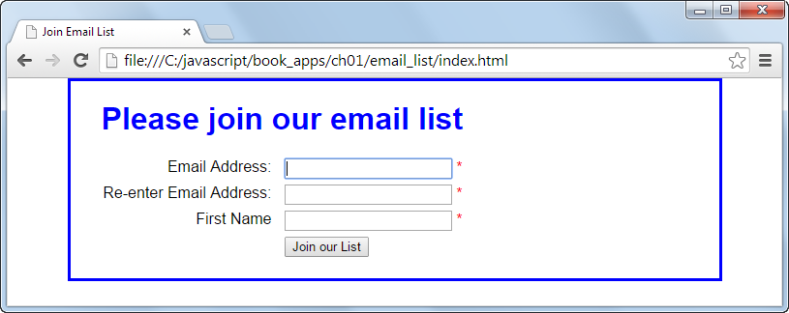
The web page at c:/javascript/book_apps/ch01/email_list/index.html

Slide 42
Four ways to run an HTML page that’s on your own server or computer

Slide 43
Two ways to run an HTML page on the Internet

Slide 44
The components of an HTTP URL on the Internet

Slide 45
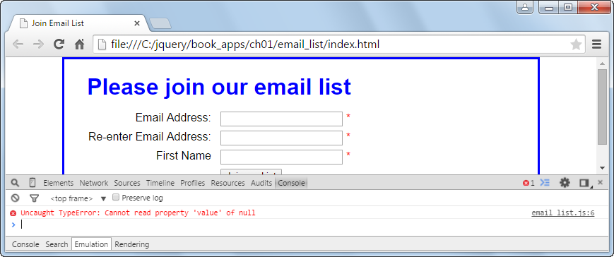
Chrome with an open Console panel that shows an error

Slide 46
How to open or close Chrome’s developer tools

Slide 47
How to find the JavaScript statement that caused the error

Slide 48
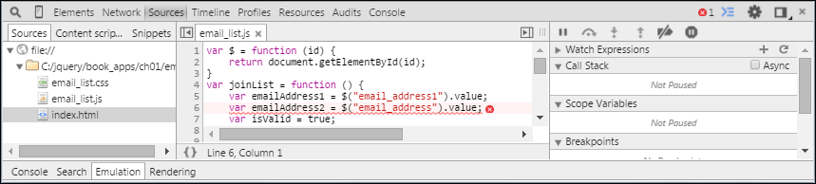
The Sources panel after the link in the Console panel has been clicked

Slide 49
The HTML5 ratings of current browsers

Slide 50
Code that includes the JavaScript shiv for HTML5 compatibility

Slide 51
The URL for downloading the normalize.css style sheet

Slide 52
The code that includes the shim.js file for ECMAScript 5 compatibility

Slide 53
Terms

Slide 54
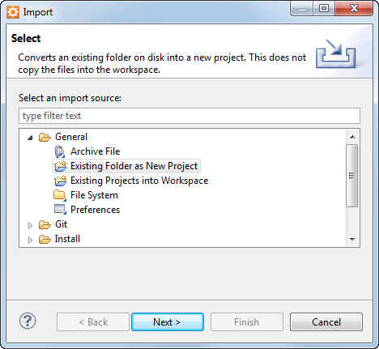
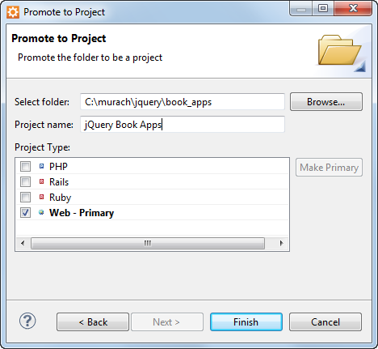
The dialog boxes for importing an Aptana project

Slide 55
How to create a new project

Slide 56
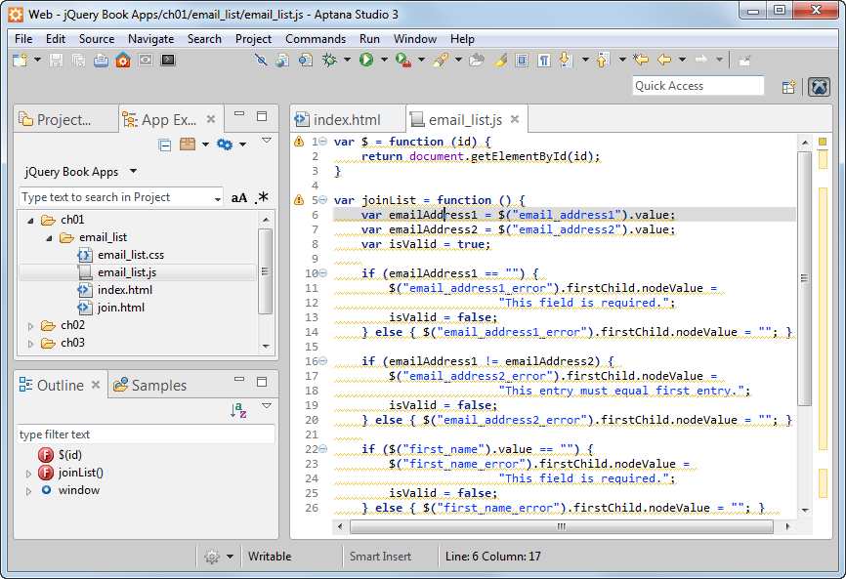
Aptana with the App Explorer shown and a JavaScript file in the second tab

Slide 57
How to open a file within a project

Slide 58
How to start a new file

Slide 59
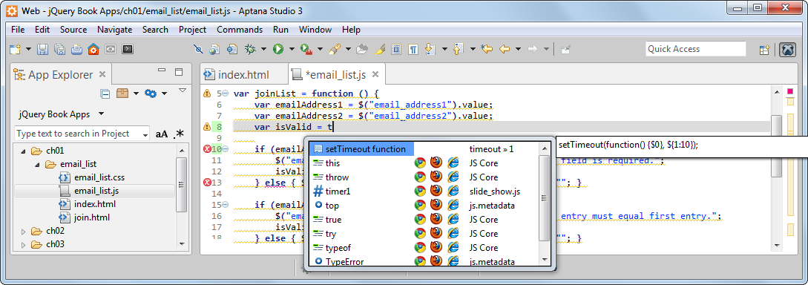
Aptana with an auto-completion list

Slide 60
How to identify errors in Aptana

Slide 61
How to hide and restore the Project and App Explorers

Slide 62
How to set the colors used to highlight the syntax

Slide 63
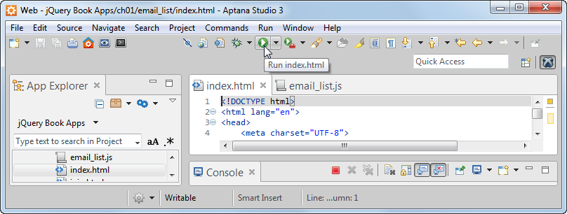
To run a web page, click on Aptana’s Run button

Slide 64
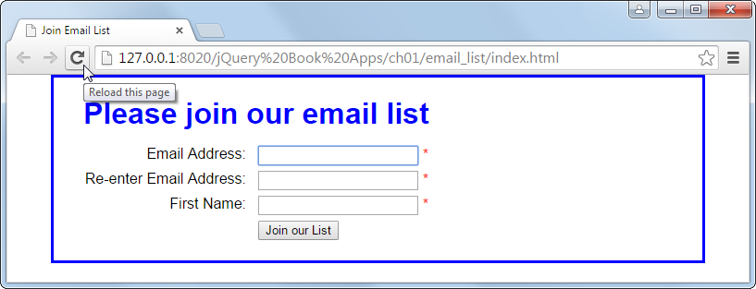
To rerun a web page in a browser, click on the Reload button

Slide 65
How to run a JavaScript application from Aptana

Slide 66
Short 1-1 Test the Email List app

